Slide 1
Subtraction
Using the Number Line Strategy

Slide 2
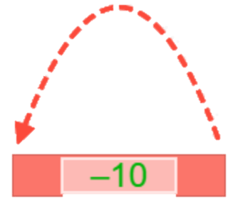
I have solved this problem, but I can’t remember how!
Show me how the number line could have helped me solve it. Type in the boxes below each jump on the number line. Then, type the correct answer in the box.
Use the number line to solve this subtraction problem:
92
-54
Type the answer here:
 |  |  |  |  |  |  |  |  | 92

Slide 3
I have solved this problem, but I can’t remember how!
Show me how the number line could have helped me solve it. Type in the boxes below each jump on the number line. Then, type the correct answer in the box.
Use the number line to solve this subtraction problem:
31
-22
Type the answer here:
 |  |  |  | 31

Slide 4
I have solved this problem, but I can’t remember how!
Show me how the number line could have helped me solve it. Type in the boxes below each jump on the number line. Then, type the correct answer in the box.
Use the number line to solve this subtraction problem:
86
-47
Type the answer here:
 |  |  |  |  |  |  |  |  |  |  | 86

Slide 5
I have solved this problem, but I can’t remember how!
Show me how the number line could have helped me solve it. Type in the boxes below each jump on the number line. Then, type the correct answer in the box.
Use the number line to solve this subtraction problem:
26
-18
Type the answer here:
 |  |  |  |  |  |  |  |  | 26

Slide 6
I have solved this problem, but I can’t remember how!
Show me how the number line could have helped me solve it. Type in the boxes below each jump on the number line. Then, type the correct answer in the box.
Use the number line to solve this subtraction problem:
43
-37
Type the answer here:
 |  |  |  |  |  |  |  |  |  | 43

Slide 7
I have solved this problem, but I can’t remember how!
Show me how the number line could have helped me solve it. Type in the boxes below each jump on the number line. Then, type the correct answer in the box.
Use the number line to solve this subtraction problem:
51
-35
Type the answer here:
 |  |  |  |  |  |  |  | 51

Slide 8
I have solved this problem, but I can’t remember how!
Show me how the number line could have helped me solve it. Type in the boxes below each jump on the number line. Then, type the correct answer in the box.
Use the number line to solve this subtraction problem:
62
-36
Type the answer here:
 |  |  |  |  |  |  |  |  | 62

Slide 9
I have solved this problem, but I can’t remember how!
Show me how the number line could have helped me solve it. Type in the boxes below each jump on the number line. Then, type the correct answer in the box.
Use the number line to solve this subtraction problem:
74
-46
Type the answer here:
 |  |  |  |  |  |  |  |  |  | 74

Slide 10
I have solved this problem, but I can’t remember how!
Show me how the number line could have helped me solve it. Type in the boxes below each jump on the number line. Then, type the correct answer in the box.
Use the number line to solve this subtraction problem:
95
-27
Type the answer here:
 |  |  |  |  |  |  |  |  | 95

Slide 11
I have solved this problem, but I can’t remember how!
Show me how the number line could have helped me solve it. Type in the boxes below each jump on the number line. Then, type the correct answer in the box.
Use the number line to solve this subtraction problem:
37
-19
Type the answer here:
 |  |  |  |  |  |  |  |  |  | 37

