Slide 1
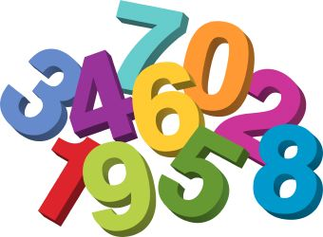
Number Sense
Teacher Directions:
On each slide, students have been given a number and its corresponding word.
They will use the INSERT, SHAPES option on the toolbar to insert the matching number of shapes.
Once they get the right number of shapes, they can color them in by using FORMAT, SHAPE FILL if you choose.

Slide 2
Four

Slide 3
One

Slide 4
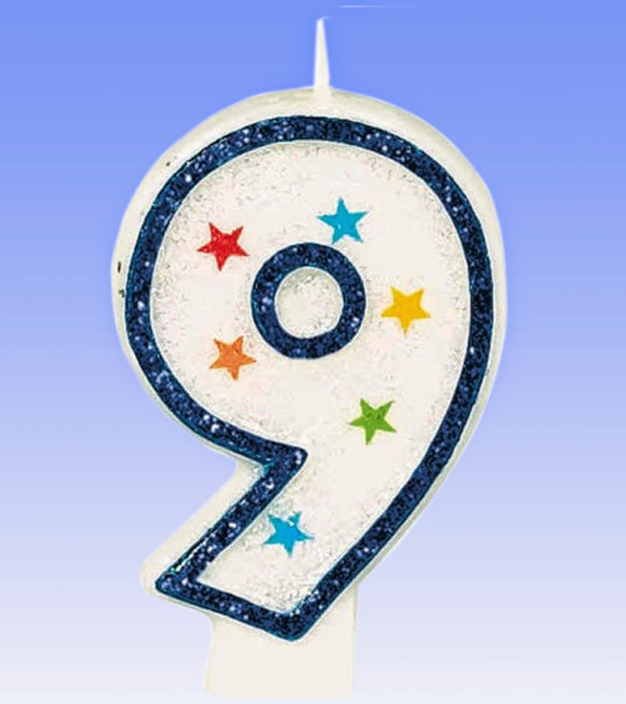
Nine

Slide 5
Three

Slide 6
Seven

Slide 7
Six

Slide 8
Ten

Slide 9
Eight

Slide 10
Five

Slide 11
Two

